Slide 1




Mode
Switching
PressrueControl
Soft
Actuator
SMC
NDOB

Slide 2
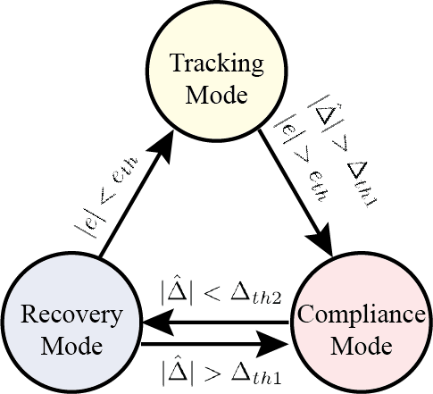
Mode Switching
Pressure Control
Soft
Actuator
SMC
NDOB

